Slide 1
Internship Presentation
Course Code: SWE 420
Kishwar Sadaf Rodushi
Reg no:2018831073
Department of Software Engineering
IICT, SUST

Slide 2
Internship At
Divine It Limited

Slide 3
About Divine It Limited
Founded in 2005
250+ employees
Currently Operating from Uttara, Dhaka
Works on their own products (PrismERP, PrismVAT, Centroid etc)

Slide 4
Internship Activities
Learning phase
Practise phase
Project work

Slide 5
Learning Phase
Python
Django
Basic HTML and CSS
Javascript

Slide 6
Python learning
Basics level
e.g. Type conversion, concept, import, statement, Lambda function, file, os module, data manipulation etc
Intermediary level
e.g. OOP concepts, function, exception handling, List, Dictionary, Map, Filter, Reduce, Unicode support etc
Advanced level
e.g. Meta class, Debugging, Regular expression, Decorator, Generator, iterator, pickle

Slide 7
Other Learnings
Django: All the resources were given by my supervisor to learn Django properly
HTML and CSS: I have went through a training process to learn HTML and CSS
Javascript: My mentor took a session on javascript
Figma: learned from online available documentation

Slide 8
Practise Phase
Case study title:
Conduct a case study for a project where sust is in need of 60 wifi router and how Divine IT Limited can have a successful delivery and implementation.
Objectives:
- analysis the process steps
-analysis the sub steps
-defining the concern person for each steps
-work process of that concern person
-How this project can be handled in a ERP system

Slide 9
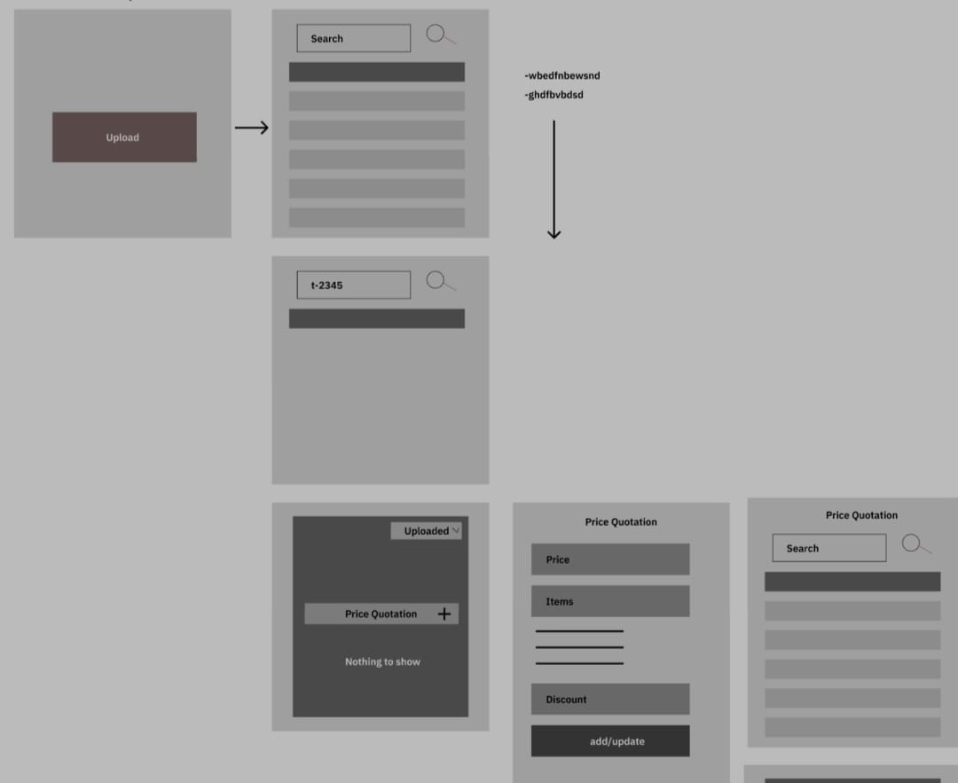
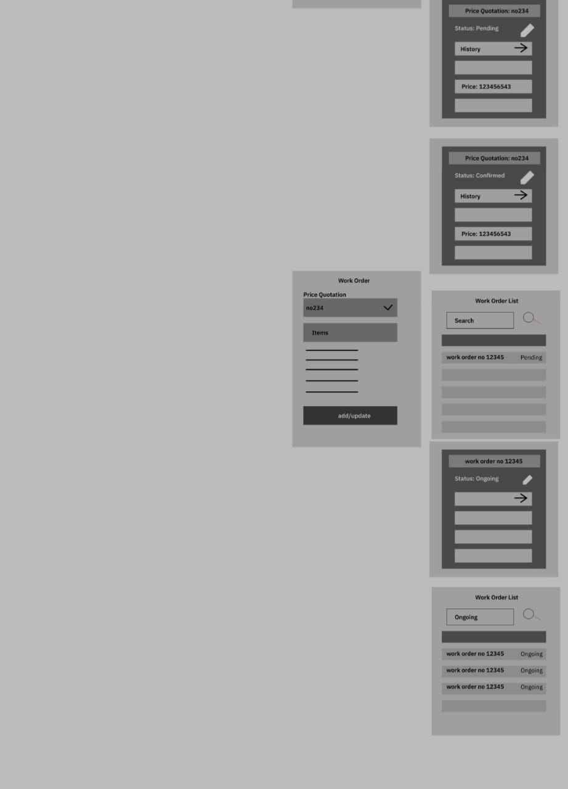
Practice phase
After the case study i was given the task to design the User Interface of the system

Slide 10
Practice phase
To do list
-create a task
-delete
-Update
-replace it. It uses the basic dom manipulation and CSS styles.

Slide 11
Practise phase
Guess my number
This is an easy and fun project to explore the topic DOM Manipulation.
-build using html, css and Javascript.
-The player has to keep guessing the number until he gets it right.
-Based on number of tries, the game score is determined.

Slide 12
Practise Phase
Personal Blog
-It is basically a project build using the basic concepts of CRUD app.
-Written articles are shown in Home page
-the About tells what’s the page is about.
-Routing was used in it.

Slide 13
Project work
Classroom app
Features of this app:
1.User login
2.Role (Teacher or Student) based authentication
3.Different frontend view for teachers and students
4.Teachers can add a new student and also can add a new teacher
5.Students can view posts and add comments on a posts
6.A teacher can edit and delete his/her own posts only
7.Teachers can view teacher list, student list and all posts with comment
8.Students can delete their own comment
9.Teachers can remove any student from the classroom

Slide 14
Challenges
● Understanding the documentation.
● Reading Code Base.
● Keeping codes manageable.
● Writing codes following industry norms.
● Communication with team members and professionalism.
● Completing the task within given time.
● Getting used to with internal libraries

Slide 15
Personal Growth
● Team work
● Communication
● Knowledge sharing
● Time management
● Professionalism
● Sincerity
● Empathy

Slide 16
Thank you!

